Slide 1
Analysis and predictive modelling of prevalence of cardiovascular diseases in U.S. states using machine learning Igor Putrenko Capstone project for Springboard Data Science Intensive workshop

Slide 2
Cardiovascular diseases (CVD)
By 2030, annual direct medical costs associated with CVD are projected to rise to 818 billion US$
Related to modifiable risk factors such as hypertension, cholesterol, obesity, tobacco use, physical inactivity and diabetes
Prevalence increases with advancing age and varies within racial, ethnic, and socioeconomic groups
Risk-prediction algorithms and models cannot fully explain the excess cardiovascular risk

Slide 3
How to prevent and control CVD?
What is the correlation between the prevalence of CVD and risk factors among different demographic groups?
What factors contribute most to the prevalence of CVD?
Do they vary for different CVD?
Can the prevalence of CVD be modelled and predicted?

Slide 4
U.S. data
Public access and use
Encompasses one-country, high-magnitude variability in socioeconomic, demographic, and geographic factors
CVD: Coronary Heart Disease, Heart Attack, and Stroke
CVD and risk factors data: BRFSS, Centers for Disease Control and Prevention
Health spending data: Kaiser Family Foundation
Socioeconomic data: Wikipedia
Average annual temperature: Current Results

Slide 5
Clients
U.S. federal and state health agencies
U.S. healthcare costs were 17.4% GDP in 2013
Economic effect of optimization of healthcare spending is hard to overestimate
Insurance companies
Premium rates for policyholders and risk assessment are calculated based on an individual’s key indicators
Correct risk assessment could save millions of dollars

Slide 6
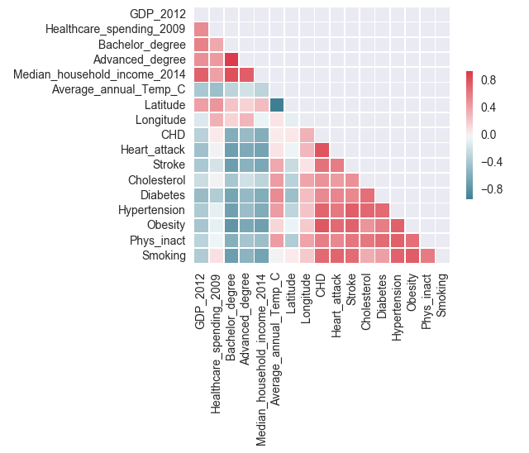
Correlation between risk factors, CVD, socioeconomic, and geographic factors

Slide 7
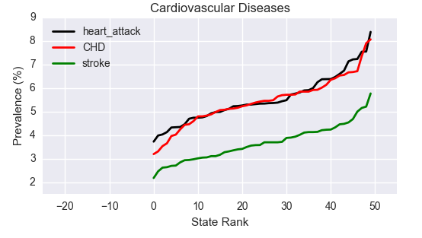
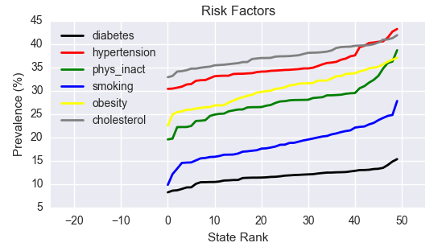
State-ranked prevalence of CVD and risk factors

Slide 8
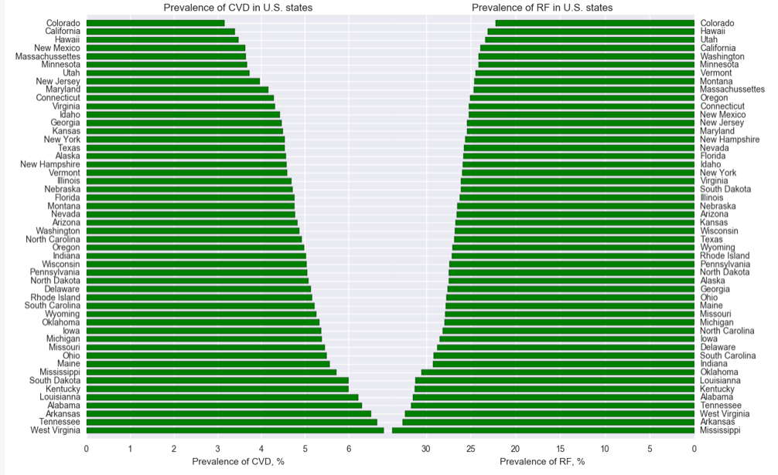
U.S. states ranked by prevalence of combined CVD and risk factors

Slide 9
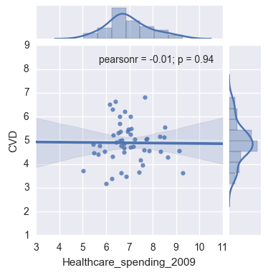
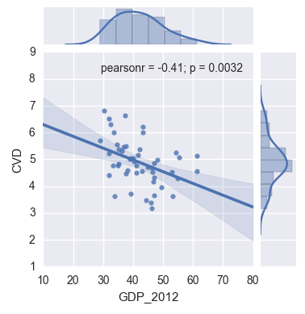
Correlation between CVD and socioeconomic factors

Slide 10
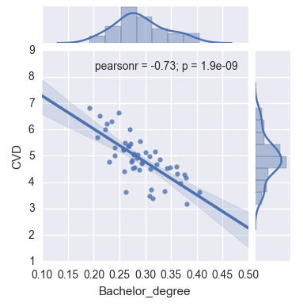
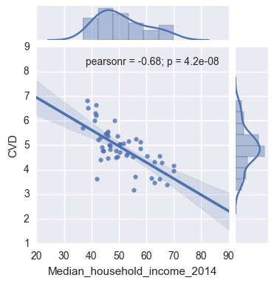
Correlation between CVD and socioeconomic factors

Slide 11
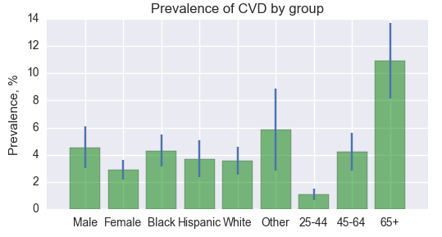
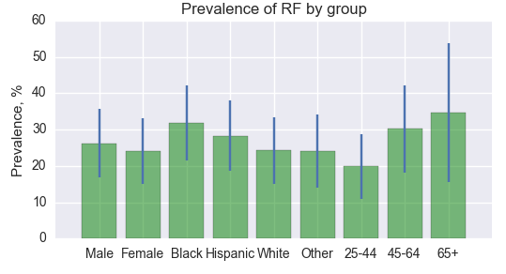
Prevalence of CVD and risk factors among various demographic groups

Slide 12
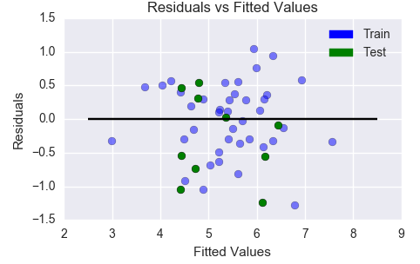
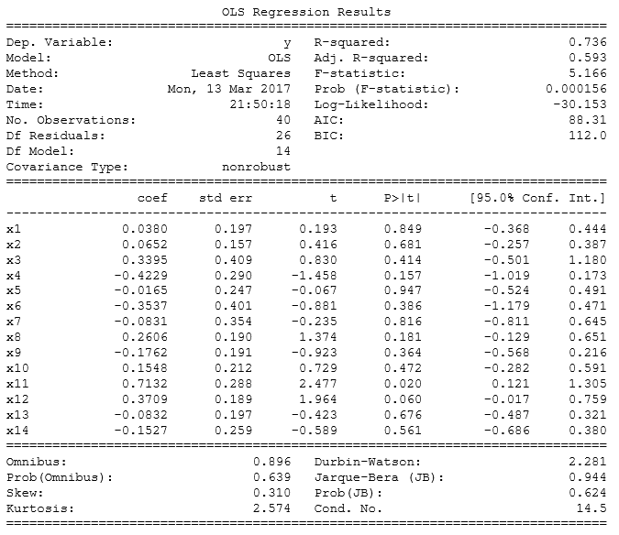
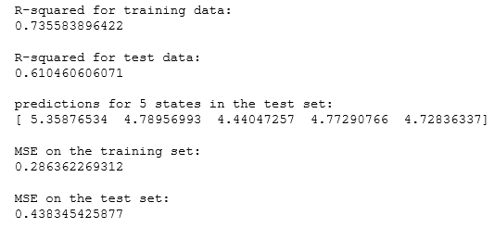
Predictive Modelling Supervised Machine Learning Linear Regression

Slide 13
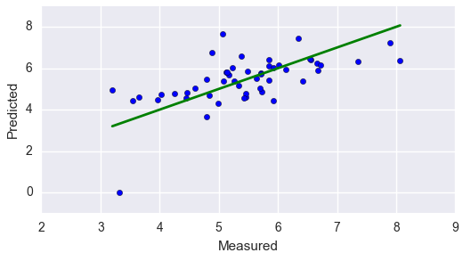

Predictive Modelling Supervised Machine Learning Linear Regression (Cross-Validation)
Cross-validation score on test data using K-Folds generator

Slide 14
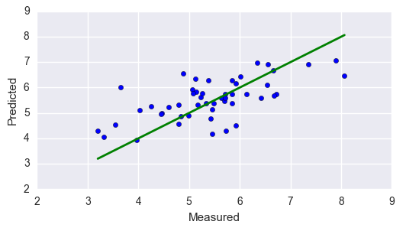
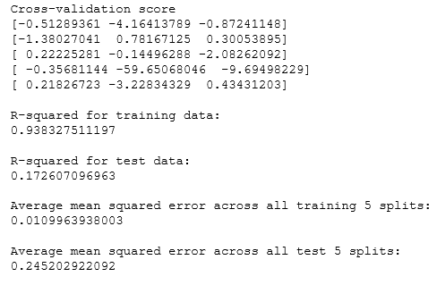
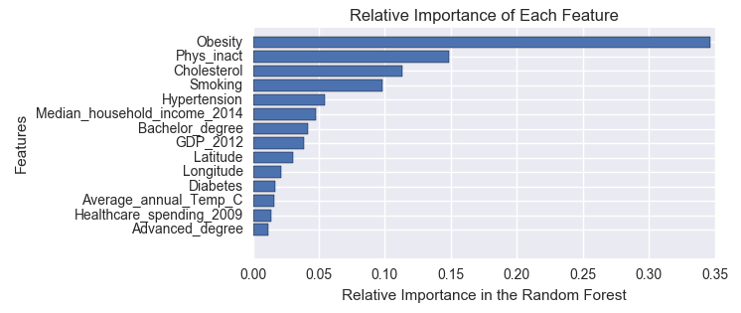
Predictive Modelling Supervised Machine Learning Random Forests (Cross-Validation) CVD type: CHD

Slide 15
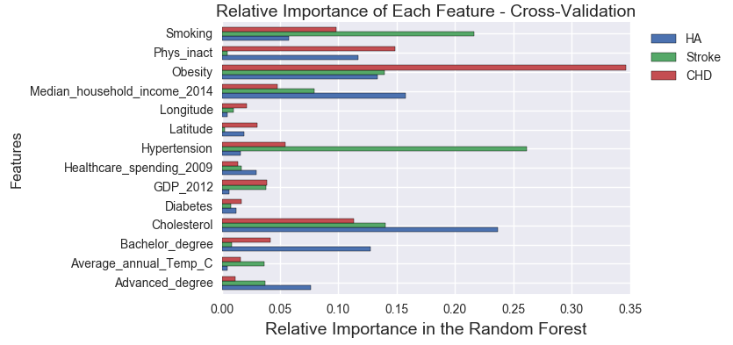
Predictive Modelling Supervised Machine Learning Random Forests (Cross-Validation)

Slide 16
Relative Importance of Risk Factors
Obesity, physical inactivity, blood level of cholesterol, and smoking are most important for the prevalence of CHD
Hypertension, smoking, obesity and cholesterol followed by household income are most important factors for prevalence of stroke
Role of socioeconomic factors is much more important for the prevalence of heart attack
The heart attack rank - Cholesterol, household income, obesity, education (Bachelor's degree), physical inactivity, and education (advanced degree)

Slide 17
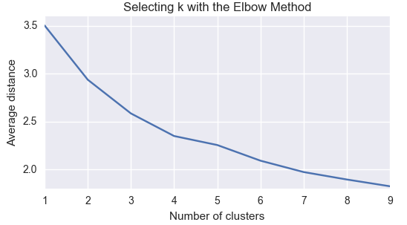
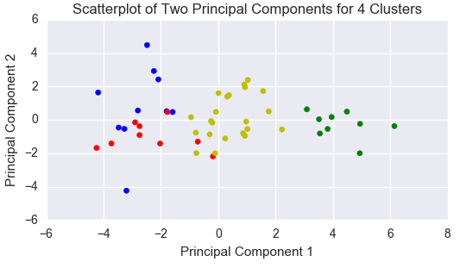
Cluster Analysis Unsupervised Machine Learning K-means

Slide 18
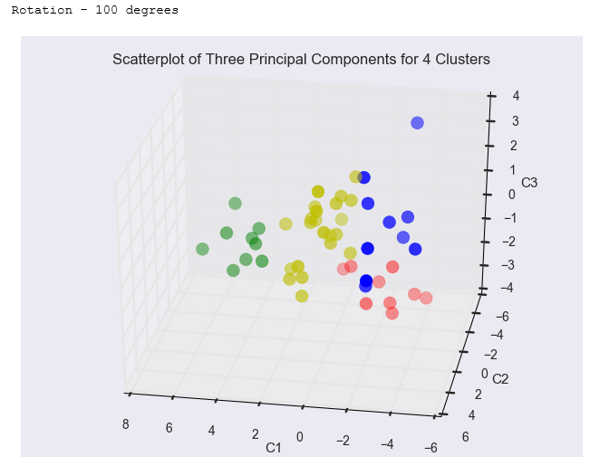
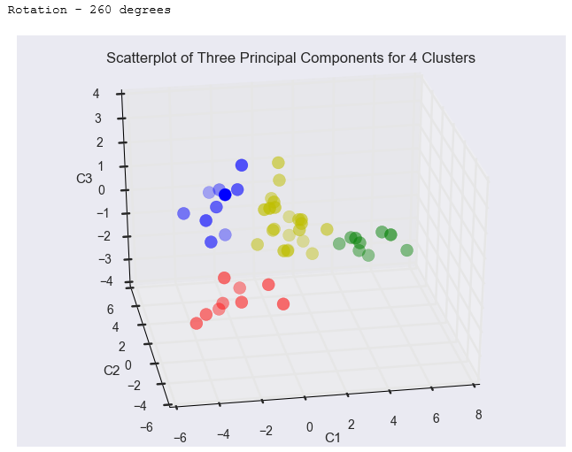
Cluster Analysis Unsupervised Machine Learning K-means (4 clusters)

Slide 19
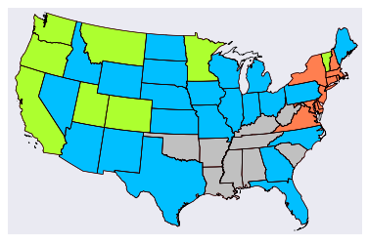
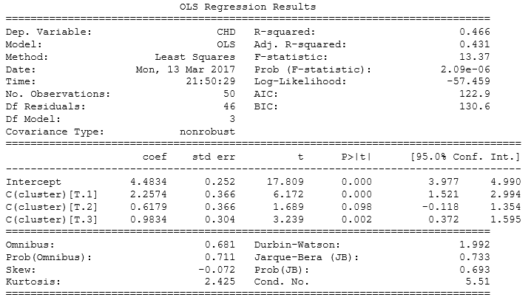
Cluster Analysis Unsupervised Machine Learning K-means (4 clusters)
Performance: OLS - CHD

Slide 20
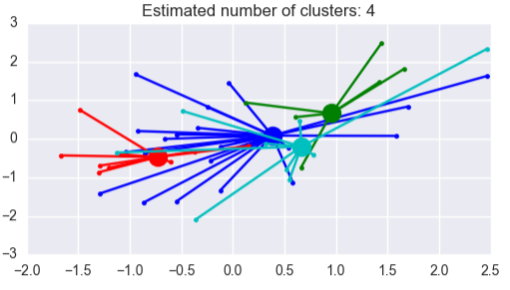
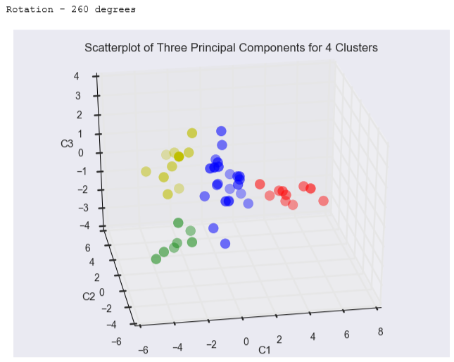
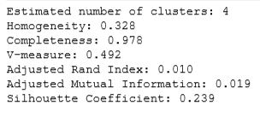
Cluster Analysis Unsupervised Machine Learning Affinity Propagation
Performance: CHD

Slide 21
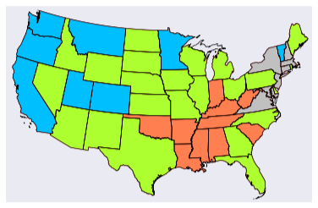

Cluster Analysis Unsupervised Machine Learning Affinity Propagation

Slide 22
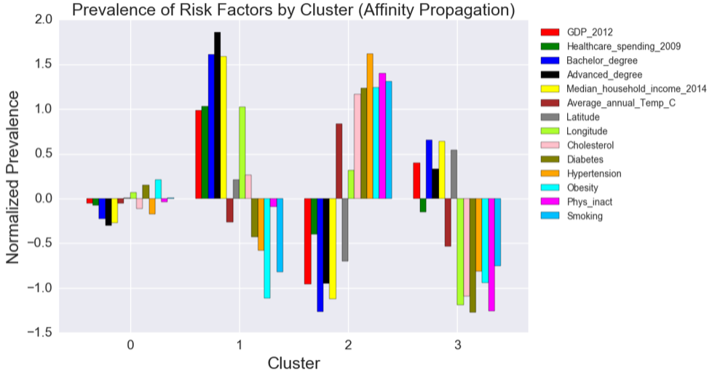
Cluster Analysis Unsupervised Machine Learning Affinity Propagation

Slide 23
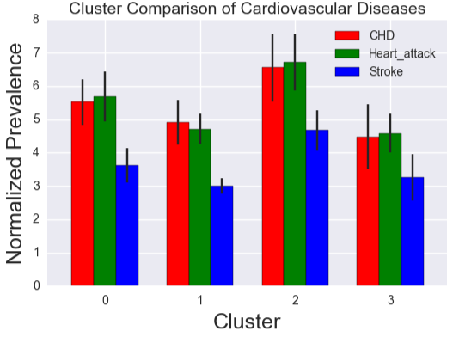
Cluster Analysis Unsupervised Machine Learning Affinity Propagation

Slide 24
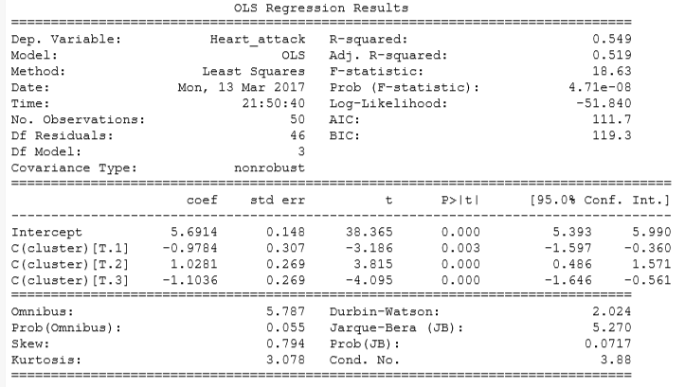
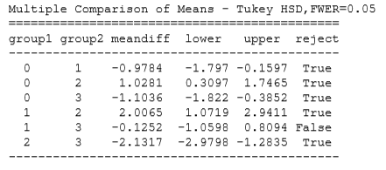
Cluster Analysis Unsupervised Machine Learning Affinity Propagation (Performance: OLS, Tukey HSD)

Slide 25
Cluster Analysis
The higher is the prevalence of traditional risk factors, the lower is the prevalence of CVD
Relationship between socioeconomic factors and CVD is more complex and is not linear
The West cluster has lowest prevalence of traditional risk factors, but it is second after the North-East cluster based on socioeconomic factors
Prevalence of traditional risk factors in the North-East cluster is ranked second
The Central cluster is ranked third based on both socioeconomic and risk factors

Slide 26
Conclusion
U.S. healthcare system is not effective in preventing CVD
Overall increase in healthcare spending will not decrease the prevalence of CVD
Efforts should be aimed at increasing public knowledge and awareness of CVD and associated risk factors
Even a less than 0.5% decrease in the prevalence of CVD would reduce its economic burden by tens of billions of US$
CVD risk assessment based on the proposed models could save millions of US$ for insurance companies

